Slide 1

Security Principle 4: Attack Surface Reduction
Minimising Access and Maximising Security

Slide 2
What is Attack Surface Reduction?
Attack Surface Reduction: total entry points into a network system that an attacker can potentially exploit (Crowdstrike.com, 2025).
By reducing unnecessary and securing access points, the attackers have fewer ways to breach the system, which makes it harder to exploit.

Slide 3
Why does Attack Surface Reduction matter?
Attack Surface Reduction matters because every access point is a potential entry, and closing them eliminates the ability to plot attacks.
Fewer access points means fewer parts of systems and configurations that need to be managed by IT members. This reduces complexity and the likelihood of overlooking security weaknesses (Joint Task Force 2020).
  A study managed to record 1,065,920 brute-force attempts against five production SSH servers in just 20 days (Raj et al., 2024). Many attackers are trying various methods to enter through different access points.
  Organisations must ensure that their access points are protected from potential attacks and only authorised users can go through them, while being able to maintain those access points.
Let's see what happens when Attack Surface Reduction fails in Ubuntu and AWS, and how to fix it.

Slide 4
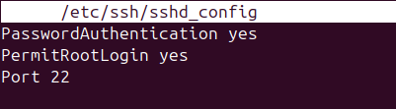
Initial Linux Vulnerable Setup
openssh-server installation – powerful tools used for remotely controlling networked computers and transferring data between them
Secure Shell (SSH) is a common method to remotely access and manage a Linux Server (Nepal, 2013).
/etc/ssh/sshd_config – file path to configure/manage the default behaviour of OpenSSH (Ubuntu Server, 2025).
  PasswordAuthentication yes – determines if authentication requires entering a valid password. In this case, a password is required to have access to the SSH server. Vulnerable because password breaches are very common and face multiple potential exploits.
  PermitRootLogin yes – allows root access to the SSH server. The root user is allowed to perform multiple tasks, such as configuring network settings and changing privilege policies (www.ssh.com, n.d.). Vulnerable because the user will have more privileges than they should – the amount should match the necessary amount needed.
  Port 22 – standard port used for SSH
Figures 1 & 2: “openssh-server” being installed & the file “sshd_config” having a vulnerable setup.

Slide 5
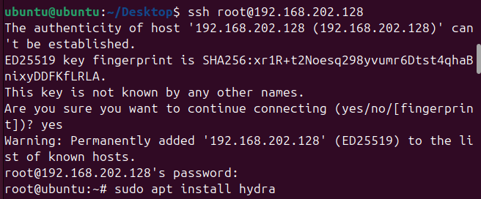
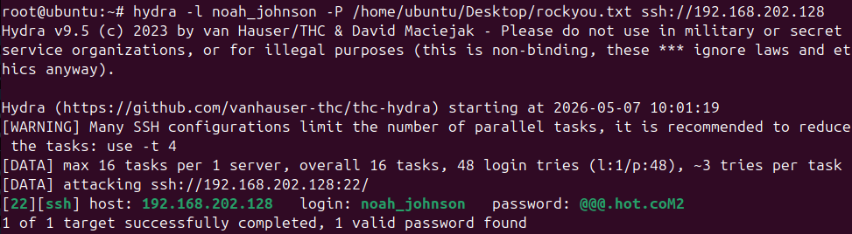
Linux Exploitation Process
ssh root@{IP ADDRESS} – logging in as a root user using the organisation’s obtained IP address to enter SSH (Ajera, 2025). This is allowed because PermitRootLogin is set to “Yes”, as shown in the previous slide.
root@{IP Address} password – system then asks for the password of the root user. The attacker enters the correct password they obtained. This is allowed because PasswordAuthentication is set to “Yes”, as shown in the previous slide.
# symbol means the user inside the SSH server.
Hydra, a password cracker application, is used against Noah Johnson. It compares the list of passwords in rockyou.txt.
rockyou.txt - a text file that contains a list of commonly used passwords (GeeksforGeeks, 2022).
Eventually, Noah Johnson’s password is obtained. His compromised account can lead to unauthorised access, allowing attackers to gain control of the organisation’s system.
Figure 3: Access of SSH server as a root user
Figure 4: Obtaining of Noah Johnson’s password using Hydra and rockypu.txt
** The root password was set personally by me, to be able to communication IF the attacker was able to find the IP address and root password.
* IP Address censored in black rectangles to protect own local machine

Slide 6
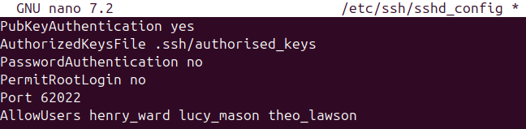
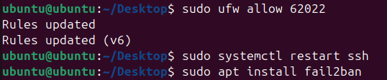
Solutions for preventing exploitation: Correcting the initial exploitation P1
Edit sshd_config – Set PasswordAuthentication and PermitRootLogin to no (Nepal, 2013).
There won’t be any password authentications, and in their place is PubKeyAuthentication, which enables authentication using a public key that only the IT department can use. This is defined using AllowUsers.
AuthorizedKeysFile determines the file path in which the keys used for SSH login are stored (Issa, 2024).
Port number is changed from 22 to 62022 to bypass attackers scanning for servers on port 22. The higher the number, the harder it is for attackers, as they won’t scan 60000+ ports.
Figure 5: “sshd_config” edited to ensure only IT department users can access SSH, and all other vulnerabilities are removed
Figure 6: Port Number changed to 62022
Install fail2ban – protects SSH server by monitoring login attempts and blocking IP addresses after many failed attempts

Slide 7
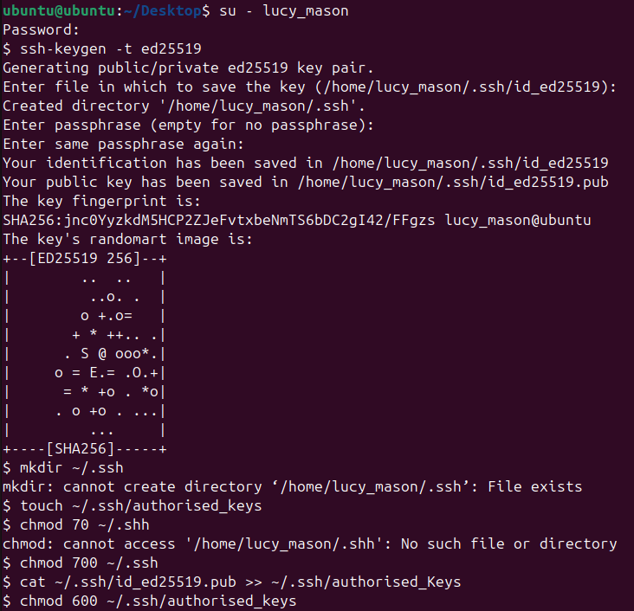
Solutions for preventing exploitation: Correcting the initial exploitation P2 (Issa, 2024)
The following steps are only for members of the IT department.
Ssh-keygen –t ed25519 – generating a key pair using Ed25519, a public-key algorithm
mkdir ~/.ssh – create ssh directory(maybe created already but do just in case)
touch ~/.ssh/authoriszed_keys – creates “authorized_keys” folder in “.ssh” directory. Contains a list of public keys allowed to access the SSH server.
chmod 700 ~/.ssh – allows only the owner to read, write, or execute files in that directory.
cat ~/.ssh/id_ed2551.pub >> ~/.ssh/authorized_keys – Copies output of public key into authroiszed_keys
chmod 600 ~/.ssh/authorized_keys: restricts access to the file to just the owner to safeguard key from other users viewing it.
Figure 7: Verification that only the IT employees can have root access

Slide 8
Solutions for preventing Ubuntu exploitation: Practices within the work environment
Periodic Reviews of assigned user privileges for each employee to determine if they have the necessary amount to perform their respective operations (Joint Task Force, 2020).
If unnecessary permission is identified, remove that error immediately.
The rights of accessing resources should be determined based on what is needed to perform their roles.
Investigate and properly assess any attempts by unauthorised users or devices to connect to the system, to identify how it has occurred and how to ensure that it doesn’t happen again.
Test access using user accounts to verify that permissions match job responsibilities.
Additional NCSC Guidance (www.ncsc.gov.uk, n.d.):
  Justify administration intent: You should be able to explain why you’ve set permissions as they’ve been set to gain approval and deter malicious insiders.
  Use appropriate approvals: Carefully consider the request by referring to the approval rules that govern access to your systems and data.

Slide 9
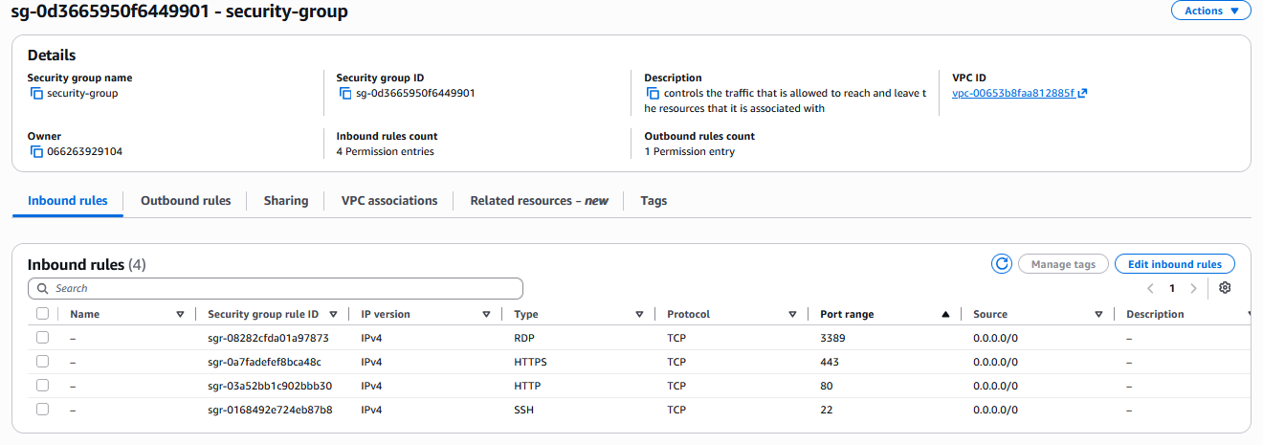
Initial AWS Vulnerable Setup
In AWS, an Amazon Elastic Compute Cloud (EC2) is a virtual machine service where you can manage storage and configure security and networking (Amazon Web Services, 2025).
In the organisation’s server, a security group named sg-0d3665950f6449901 is attached to it.
A security group controls the inbound and outbound traffic for the EC2 instance. It acts as a virtual firewall (AWS, 2024).
The firewall allows traffic displayed in the Source column. 0.0.0.0/0 means any incoming communication can access the services listed in the Type column, which can be accessed freely and easily on the specified port number.
Unrestricted traffic increases the risk for malicious activity, such as hacking, denial-of-service and loss of data (Amazon.com, 2025). Since this is the organisation's sensitive data, access should be restricted to authorised employees only.
Figure 8: Security Group of the EC2 instance

Slide 10
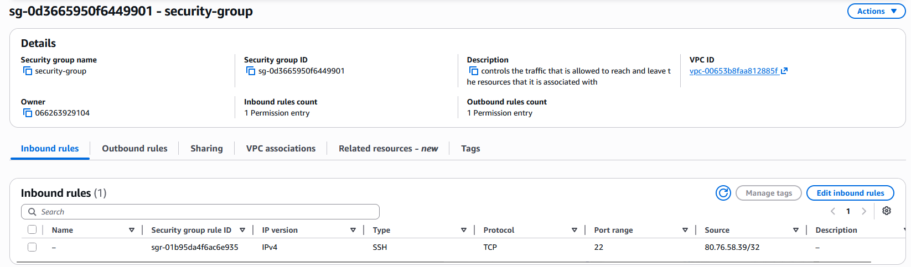
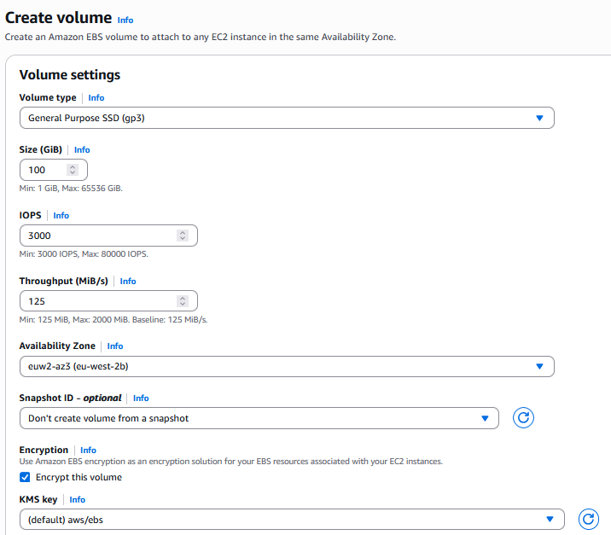
Solutions for solving the exploitation in AWS
Remove 0.0.0.0 error – Adjust Source column from allowing 0.0.0.0 (anywhere) to the specific authorised IP address in relation to the organisation. Ensures only employees can access the EC2 instance, and removes public access to potential attackers.
Make sure the Type columns only contain services/protocols you will use; in this case, the organisation is using SSH and has removed the others.
Enable Encryption on Storage – Create an encrypted snapshot of the Elastic Block Store (EBS) volume to back up the data (Amazon Web Services, Inc., n.d.). It is encrypted to protect it as it is in an unreadable form. Even if the system was to be compromised, the attacker could not read the data.
Create an Encrypted volume – Create a new encrypted volume from the snapshot and attach to the EC2 instance. Replaces unencrypted storage with an encrypted volume, protecting stored data.
Maintain Availability Zone – Make sure the new volume is in the same availability zone as the EC2 instance to be able to use it.
Figure 9: Removal of 0.0.0.0 error, and unnecessary type of services as the organisation didn’t need them
Figure 10: Creation of Volume with Encryption enabled. Eu-west-2b is the availability zone chosen.
* IP address in Source Column in Figure 9 censored for personal identifiers

Slide 11
Solutions for preventing AWS exploitation: Practices within the work environment
Restrict inbound network access to only IP addresses of the employees, following the principle of least privilege.
Investigate and properly assess any attempts by unauthorised users or devices to connect to the system, to identify how it has occurred and how to ensure that it doesn’t happen again.
Minimise connectivity to external networks and internet services – ensure the amount of connectivity is at the right essential amount for your organisation to operate at (Ncsc.gov.uk, 2025).
When implementing privilege and access procedures, you should be able to explain why you’ve set permissions as they’ve been set to gain approval within employees of organisation (www.ncsc.gov.uk, n.d.).

Slide 12
Summary
Attack Surface Reduction is the total entry points into a network system that an attacker can potentially exploit
Reducing and securing access points results in the attackers having fewer ways to breach the system.
Using Ubuntu, we covered how password authentication and root users were exploited to gain passwords in an SSH server. This was solved by disabling root user access and password logins, while enabling SSH key-based authentication for a specified group of users
In AWS, we discovered that the EC2 instance had freely allowed traffic in and out of it, and this was resolved by restricting access to only authorised employees and securing and encrypting data storage.
Review the access privileges each user has and make sure they have the justifiable minimum and optimal level required for operations.
If there’s any attempt at unauthorised access to the system, investigate how it happened and how to ensure the type of attack doesn’t happen again.

Slide 13
References
Crowdstrike.com. (2025). What is Attack Surface Reduction? | CrowdStrike. [online] Available at: https://www.crowdstrike.com/en-gb/cybersecurity-101/exposure-management/attack-surface-reduction/
Joint Task Force (2020). Security and Privacy Controls for Information Systems and Organizations. Security and Privacy Controls for Information Systems and Organizations, [online] 5(5). doi:https://doi.org/10.6028/nist.sp.800-53r5.
Raj, A., Chauhan, M., Virender Kumar Chhoker, Rani, M., Bajrang Kumar Singh, Roshan D’Souza and Jatin Bodwal (2024). Brute forcing on secured shell servers emphasising the role of cyber forensics – a quali-quantitative study. Medico-Legal Journal. doi:https://doi.org/10.1177/00258172241236269.
Nepal, A.K. (2013). Linux Server & Hardening Security. [online] doi:https://doi.org/10.13140/2.1.5079.2329.
Ubuntu Server. (2025). OpenSSH server. [online] Available at: https://ubuntu.com/server/docs/how-to/security/openssh-server/.
www.ssh.com. (n.d.). What is a Root User Account? How to Root Phones? [online] Available at: https://www.ssh.com/academy/pam/root-user-account.
Ajera, J. (2025). Enabling SSH in Ubuntu Server. [online] DEV Community. Available at: https://dev.to/jajera/enabling-ssh-in-ubuntu-server-61b.
Issa, A. (2024). A Guide To Securing Your Remote Access Using SSH Keys. [online] Medium. Available at: https://infosecwriteups.com/a-guide-to-securing-your-remote-access-using-ssh-keys-84b48097f3bf
Amazon Web Services (2025). What Is Amazon EC2? - Amazon Elastic Compute Cloud. [online] Amazon.com. Available at: https://docs.aws.amazon.com/AWSEC2/latest/UserGuide/concepts.html.
AWS (2024). Control traffic to resources using security groups - Amazon Virtual Private Cloud. [online] docs.aws.amazon.com. Available at: https://docs.aws.amazon.com/vpc/latest/userguide/vpc-security-groups.html.
Amazon.com. (2025). Security control recommendations for protecting infrastructure - AWS Prescriptive Guidance. [online] Available at: https://docs.aws.amazon.com/prescriptive-guidance/latest/security-controls-by-caf-capability/infrastructure-controls.html.
Amazon Web Services, Inc. (n.d.). Amazon EBS Snapshots | Backup & Data Protection Service | Amazon Web Services. [online] Available at: https://aws.amazon.com/ebs/snapshots/.
Ncsc.gov.uk. (2025). Principle 5: Reduce the attack surface. [online] Available at: https://www.ncsc.gov.uk/collection/principles-for-secure-paws/reduce-attack-surface.

